Slide 1
Issue that I am facing!
LTTng Tools does successfully start tracing all or specific events in userspace, but doesn’t log the traces (CTF logs) (please refer snaps at next slides).
All the files including lttng-ust is ported.
Last two slides list out all the lttng related files that are available/ported in the system.
SoC has – ARM-Cortex A9 and openWRT Linux with RT Patch 75.

Slide 2
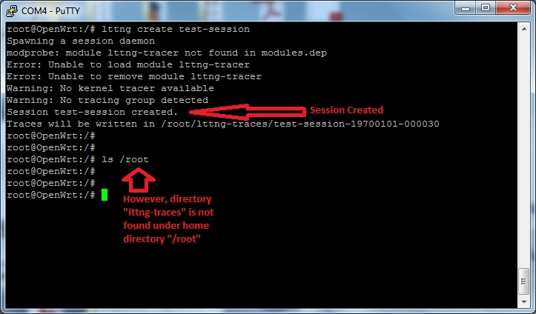
LTTng-Session Successful
LTTng Session created successfully (however I don’t see lttng-traces directory being created in home).

Slide 3
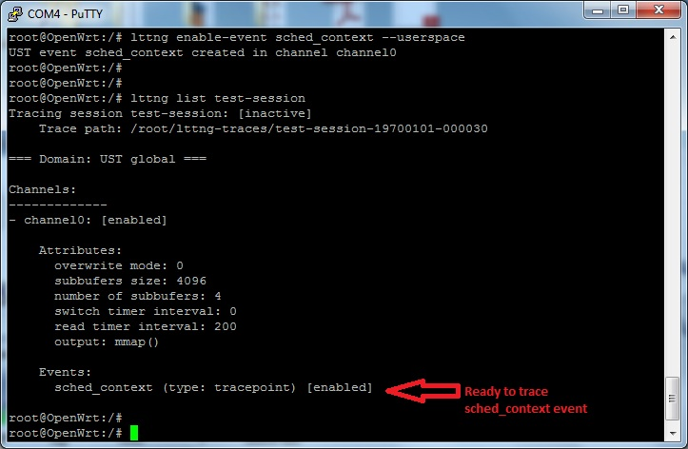
LTTng- Event creation Successful in userspace

Slide 4
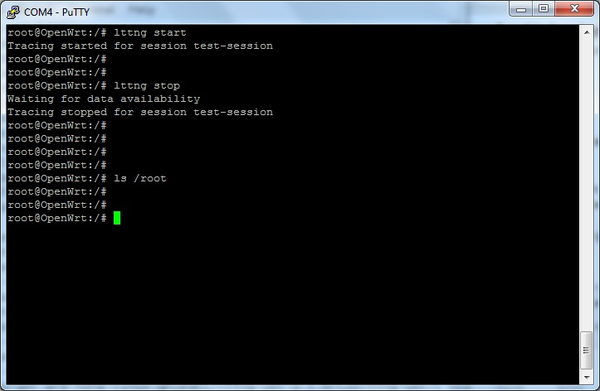
LTTng- Tracing Start/Stop in userspace But not CTF logged
Tracing started successfully in user space for the specified event but not logged in Home directory (as /root shows no file/directory under it).

Slide 5
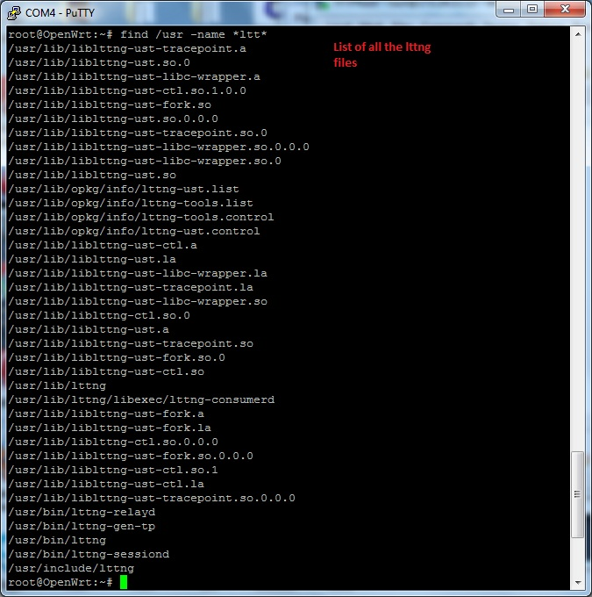
LTTng – All the needed files seeming are available.

Slide 6
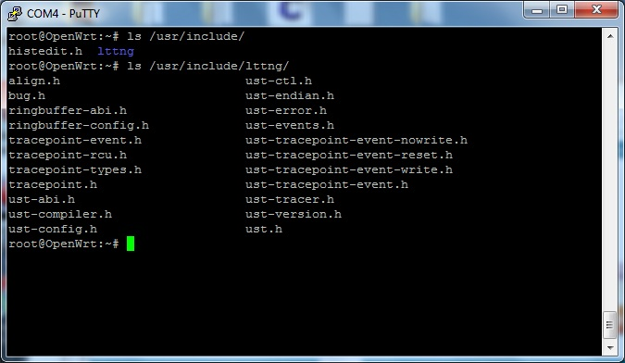
LTTng – Some header files.

